Slide 1

Machine Learning Based Student Activity Monitoring System For An Educational Institute
Group No. 09
Loveritu Itnare-19104028
Simran Choudhary-19104023
Janhavi Kulkarni-19104062
Project Guide
Prof.Kiran Deshpande
Prof. Jayshree Jha

Slide 2
Contents
Abstract
Introduction
Objectives
Literature Survey
Problem Definition
Technological Stack
Proposed System Architecture/Prototype

Slide 3
1.Abstract
Humans have always been identified by visual methods and obtain observable facts through our eyes.
The device must detect among statistics which ideas represent specific information, and large-scale facial recognition includes technologies relevant to building facial recognition machines .
Using this technique of facial recognition for retrieving information related to an individual useful for educational institutions.
We are building a system in which we will store image data of students along with other details. Identified student image will be captured and with the help of machine learning which will be fetched
Also fetched information will be used to notify authorities.

Slide 4
2. Introduction
As we know, mostly facial features are used to recognize a person.
The ability to recognize and detect facial features which is enhanced by current technologies like AI & Ml.
For those who are out of discipline and ignorant towards the rules of the college and surrounding premises these techniques can be beneficial.
Face Recognition/detection is a distinctive technology which has grown speedily in recent years.
This image will collate with the images in the database and result will be displayed after scanning on the application.

Slide 5
3. Objectives
To design and develop comprehensive cross platform application for monitoring and identifying students involved into notorious activities.
To orchestrate use of ML in the application developed for calling students doing notorious activities.
To orchestrate use of cloud computing for providing scalability to comprehensive student monitoring system developed.

Slide 6
4.Literature Survey
Sr | Paper title | Author | Abstract
1 | Deep Unified Model For Face Recognition Based on Convolution Neural Network and Edge Computing IEEE 2019 | Muhammad Zeeshan Khan zaad Khan Razi Iqbal (Senior Member IEEE) | This paper proposes an algorithm for face detection and recognition based on convolution neural networks (CNN), which outperform traditional techniques.
2 | Recent Advances in Deep Learning Techniques for Face Recognition IEEE 2021 | MD. Tahmid Hasnan Fuad Awal Fime Delowar Sikder Mabrook(Senior Member, IEEE) | In this paper comprehensive analysis of various FR systems that leverage the different types of DL techniques, and for the study, they have summarized 171 recent contributions from this area.
3 | A Review of Face Recognition Technology IEEE 2021 | Lixiang Li Xiaohui Siying Li Haipeng Peng | This paper described the development stages and related technologies of face recognition, including early algorithms, artificial features and classifiers, deep learning .They have used is a simple process of feature extraction where PCA is combined with face recognition by using K-Nearest-Neighbor (KNN) algorithm.

Slide 7
4.Literature Survey
SR.NO | Paper title | Author | Abstract
4 | Multi-view intrinsic low-rank representation for robust face recognition and clustering IEEE 2022 | Zhi-yang Wang Stanley Ebhohimhen Abhadiomhen Zhi-feng Liu Xiang-jun Shen Wen-yun Ga Shu-ying Li | The Author have developed a framework for automatic face recognition based on CCTV images using different machine learning algorithms in this work.
5 | A Real-Time Framework for Human Face Detection and Recognition in CCTV Images IEEE 2021 | Rehmat Ullah Hassan Hayat Afsah Abid Siddiqui Uzma Abid Siddiqui Jebran Khan Farman Ullah Shoaib Hassan Laiq Hasan Waleed Albattah Muhammad Islam | In this paper, the author proposed a novel multi-view low-rank representation method. The method follows hierarchical Bayesian methods and learns intrinsic and specific representation among each view via a consistent structure and diversity regularization.

Slide 8
5. Problem Definition
Problem Identified is that students are not wearing identity card and are practicing mischievous activities in college campus. To overcome this, we have proposed a system in which we will also add image of individual so that it will be easy to find the student and revert their details to authorities quickly.

Slide 9
6.Technology Stack
Flutter
Machine learning algorithm
CLASSIFIERS
AWS Cloud framework
PYTHON

Slide 10
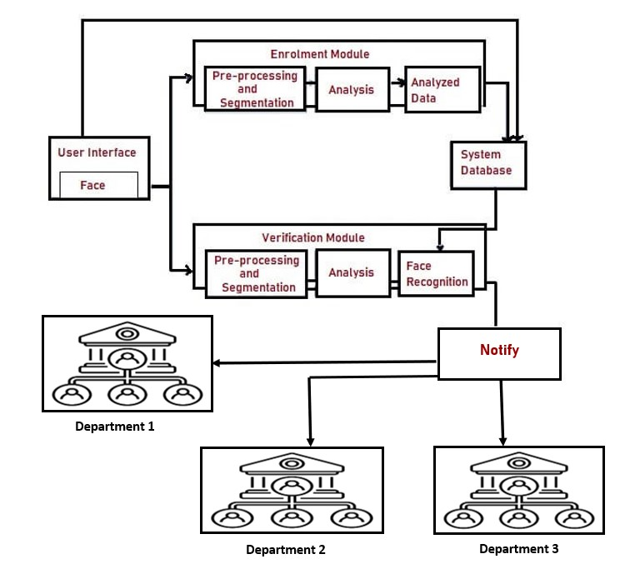
7. Proposed System Architecture/Prototype

Slide 11
Cloud Interface
Capture image
Fetching Data from cloud database using Ml
Sending data
User Interfcae
Departmental Authorities

Slide 12
Thank You...!!

